Slide 1
🤖 ROBOTICS COURSE — SESSION 8
Welcome to Robotics!
Let’s make the robot intelligent with a better performance

Slide 2
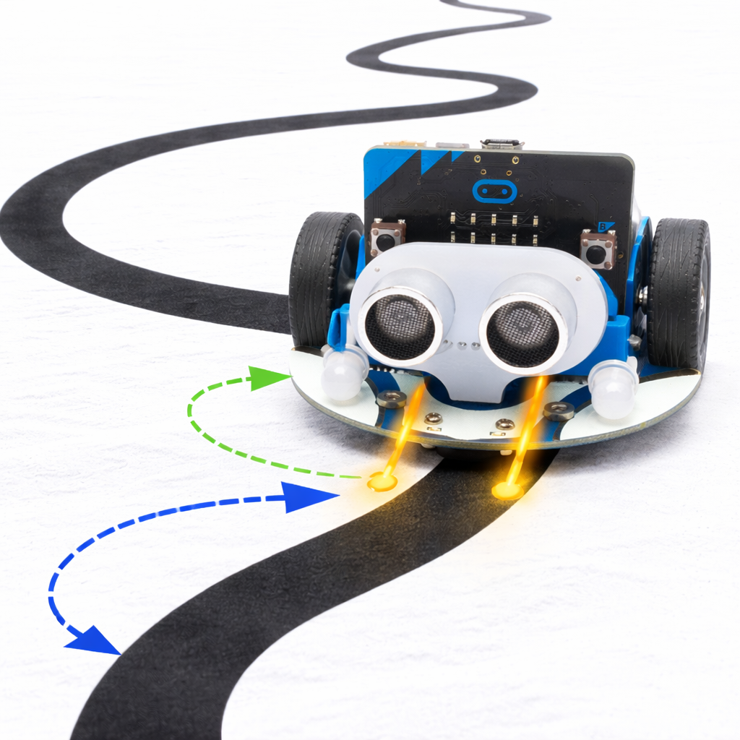
🎯 TODAY’S GOAL
Today students will learn how to make Cutebot smarter
👁️ Use a filter to make better decisions from noisy sensor readings
📐 Apply PD control to adjust how strongly the robot turns
🔍 Create a recovery strategy so the robot can find the line again if it gets lost

Slide 3
👁 The Robot Has 2 Eyes (Sensors)
L
R
L
R
L
R
← Left
Right →
Left on line
Turn LEFT
Right on line
Turn RIGHT
L
R
L
R
↑ Straight
?? Search
Both on line
Go STRAIGHT
No line seen!
SEARCH mode

Slide 4
Code Overview
① Filter
② PD Control
③ Search Mode
45 sensor samples
Proportional + Derivative
lastError memory
Reads the sensor 45 times per cycle and counts votes. Removes noise so a single false reading doesn't steer the robot.
Computes a normalized error and applies kp (strength) and kd (damping) to smoothly correct direction without oscillating.
When the line is lost (whiteCount ≥ 30), the robot spins in the direction it last saw the line until it finds it again.

Slide 5
🗳 The Filter — Let's Vote! (45 times)
The sensor is read 45 times. Each reading is a VOTE → the majority wins!
Robot drifts LEFT
Robot is CENTERED
Robot drifts RIGHT
← Left votes: 32 (32/45)
← Left: 5 (5/45)
← Left: 4 (4/45)
Right votes: 4 (4/45)
Right: 6 → (6/45)
Right: 33 → (33/45)
Center: 9 (9/45)
Center: 34 (34/45)
Center: 8 (8/45)
Turn RIGHT →
Go STRAIGHT ↑
Turn LEFT ←

Slide 6
📐 PD Control — How Hard Should It Turn?
kp = 55 (Strength)
kd = 20 (Brakes)
Small drift
→
Gentle turn
Without kd:
Medium drift
→
Medium turn
😵 Oscillates
With kd:
Big drift
→
Sharp turn
😊 Smooth curve!
kd brakes before overshoot!
More drift = More correction!

Slide 7
🔍 Search Mode — Find the Line Again!
1 On the Line
2 Line Lost! 😱
3 Searching...
L
R
L
R
L
R
→
→
30+ white readings.
whiteCount ≥ 30
→ SEARCH MODE!
Spin the way lastError
points. Keep spinning
until line found!
Robot follows the line.
lastError remembers
which side it drifted.
🧠 lastError = memory! Robot always knows which way to turn.

Slide 8
⚙️ Parameters:
👁
🗳
📐
🚗
① Sample
② Filter
③ Control
④ Move!
Read sensor
45 times
→
Count votes
Find majority
→
kp × error
+ kd × change
→
Set wheel
speeds
baseStraight = 45
baseTurn = 30
kp = 55
kd = 20
searchSpeed = 45
samples = 45
threshold =
30 / ±5
🔍 If whiteCount ≥ 30 → Skip control → Spin toward lastError direction until line is found again!

Slide 9
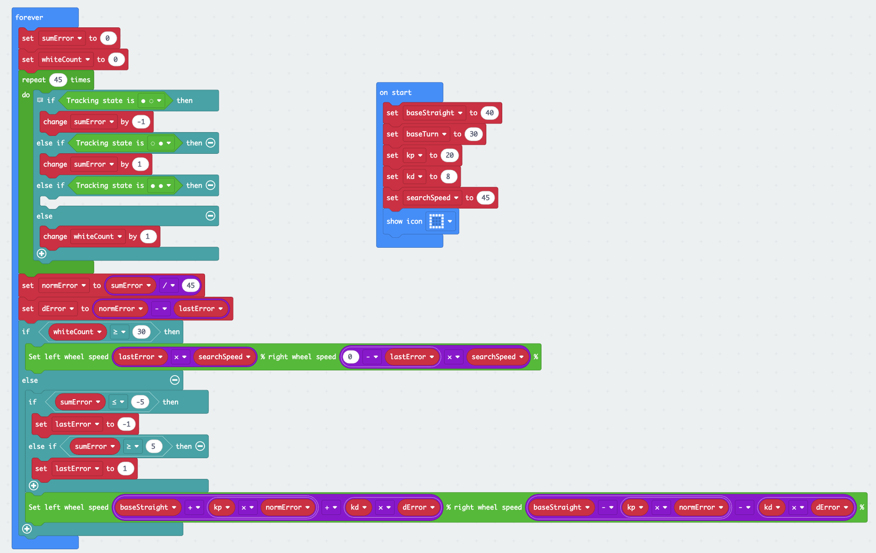
👨‍💻 ROBOT CODE

Slide 10
let lastError = 0
let dError = 0
let normError = 0
let whiteCount = 0
let sumError = 0
let baseStraight = 40
let baseTurn = 30
let kp = 20
let kd = 8
let searchSpeed = 45
basic.showIcon(IconNames.Square)
basic.forever(function () {
sumError = 0
whiteCount = 0
for (let index = 0; index < 45; index++) {
// intersección
if (cuteBot.tracking(cuteBot.TrackingState.L_line_R_unline)) {
sumError += -1
} else if (cuteBot.tracking(cuteBot.TrackingState.L_unline_R_line)) {
sumError += 1
} else if (cuteBot.tracking(cuteBot.TrackingState.L_R_line)) {
} else {
whiteCount += 1
}
}
normError = sumError / 45
dError = normError - lastError
if (whiteCount >= 30) {
cuteBot.motors(lastError * searchSpeed, (0 - lastError) * searchSpeed)
} else {
if (sumError <= -5) {
lastError = -1
} else if (sumError >= 5) {
lastError = 1
}
cuteBot.motors(baseStraight + kp * normError + kd * dError, baseStraight - kp * normError - kd * dError)
}
})

Slide 11
